Slide 1


Unlocking Digital Evidence Utilizing And Save Wizard In Forensic Analysis
TEAM MEMBERS:
AISHWARYA MS (211423104017)
DAKSHINI KANNA L(211423104104)
PROJECT GUIDE:
Mrs. K. Cinthuja, M.E., Assistant Professor

Slide 2
AGENDA
Abstract
Introduction
Objective
Literature survey
Problem statement
Architecture and diagram
Modules
Algorithms and methodology
Testing and validation
Performance analysis
Conclusion, future works, references

Slide 3
ABSTRACT
Digital devices contain encrypted forensic evidence difficult to access
Save Wizard tool aids in decrypting and analyzing PlayStation save files
Integration of Save Wizard enhances forensic workflow and data accuracy
Project evaluates machine learning for evidence validation
Ethical and legal considerations addressed for admissibility
Results show improved efficiency and evidence preservation

Slide 4
INTRODUCTION
Digital forensics recovers and analyzes electronic evidence
Challenges posed by encryption and proprietary formats
Forensic importance of unlocking digital evidence from gaming consoles
Save Wizard's potential to bypass encryption barriers
Ethical and legal frameworks guide tool usage to maintain evidence integrity

Slide 5
OBJECTIVE
.
Develop automated approach using Save Wizard for forensic data extraction
Preserve evidence integrity and chain of custody
Compare proposed automated approach with manual forensic methods
Demonstrate improvements in speed, accuracy, and reliability

Slide 6
LITERATURE REVIEW
Paper No. | Title | Type | Key Focus/Contribution | Year
1 | Industrial Temperature Monitor Based on NodeMCU | Conference | IoT device monitoring using ESP8266 and MQTT | 2021
2 | Robotic Car using NodeMCU ESP8266 Wi-Fi Module | Conference | Wireless communication in robotics | 2023
3 | Variable Speed Control Using Leap Motion and NodeMCU ESP8266 | Conference | Gesture recognition with wireless control | 2023
4 | Distributed Consensus Algorithms for Wireless Sensor Network | Conference | Consensus algorithms in sensor networks | 2018
5 | Group Heart Rate Monitoring Prototype Using NODEMCU ESP8266 | Conference | Health monitoring system prototype | 2017
6 | Forensic Examination of Handheld Gaming Console "Steam Deck" | Conference | Gaming system forensic techniques | 2024

Slide 7
7 | AI and Machine Learning in Digital Forensics and Incident Response | Survey Paper | Role of AI in forensic analysis | 2024
8 | Foundations of Mobile Forensics | Academic | Mobile forensics fundamentals | 2024
9 | Security and Digital Forensics of Video Games | Conference | Forensic methods for gaming systems, including Save Wizard | 2025
10 | Impact of AI on Digital Forensics | Review Paper | Overview of AI applications in forensics | 2024
11 | Prevalence of Game Consoles in Criminal Investigations | Case Study | Usage of gaming consoles as evidence sources | 2024
12 | Forensics Practitioner & Tooling Trends | Review | Community surveys on forensic tools and automation needs | 2024

Slide 8
PROBLEM STATEMENT
Traditional forensics struggles with encrypted, proprietary file formats
Manual decryption is error-prone and inefficient
Lack of automation reduces evidence recovery quality and speed
Need for secure, automated, and reliable forensic tools

Slide 9
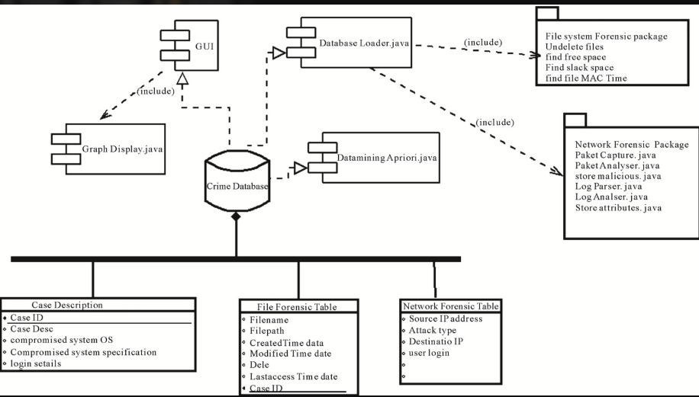
SYSTEM ARCHITECTURE DIAGRAM

Slide 10
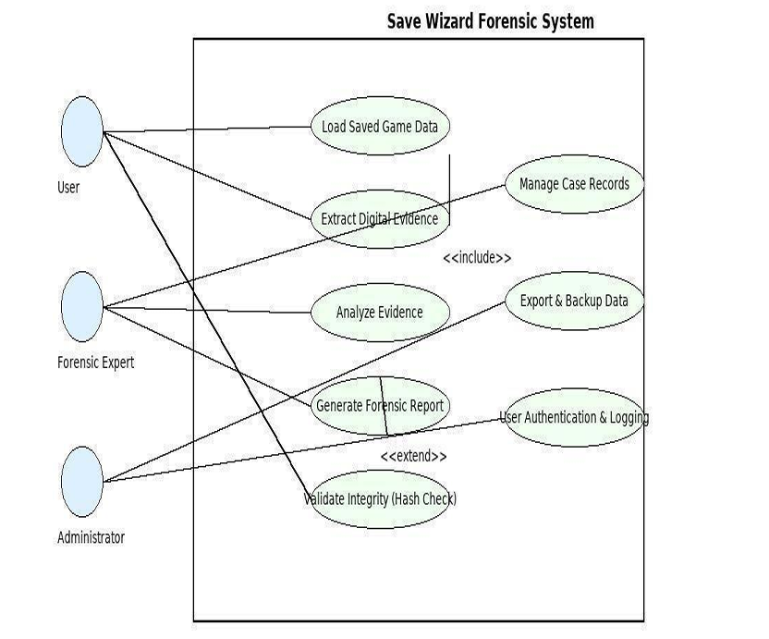
USE CASE DIAGRAM

Slide 11
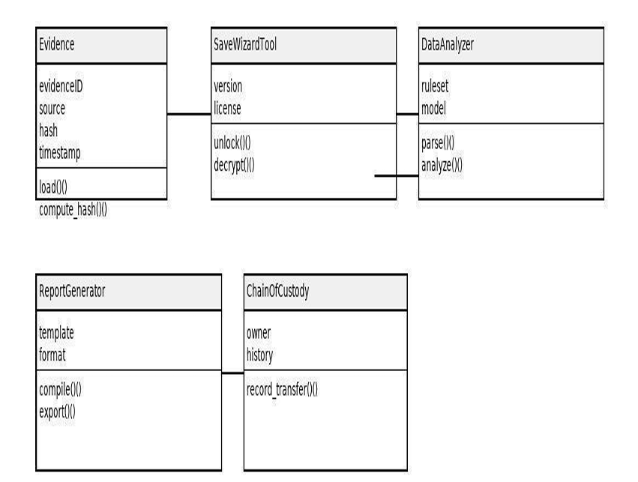
CLASS DIAGRAM

Slide 12
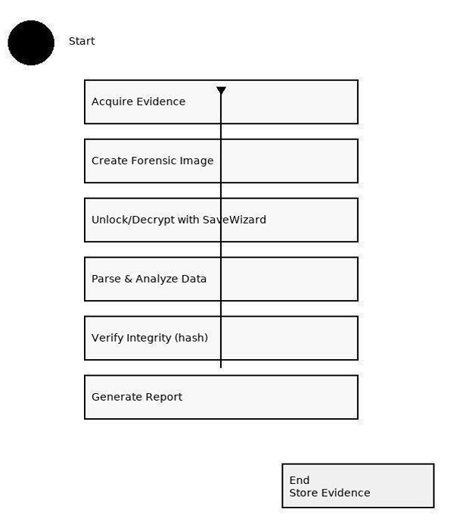
ACTIVITY DIAGRAM

Slide 13
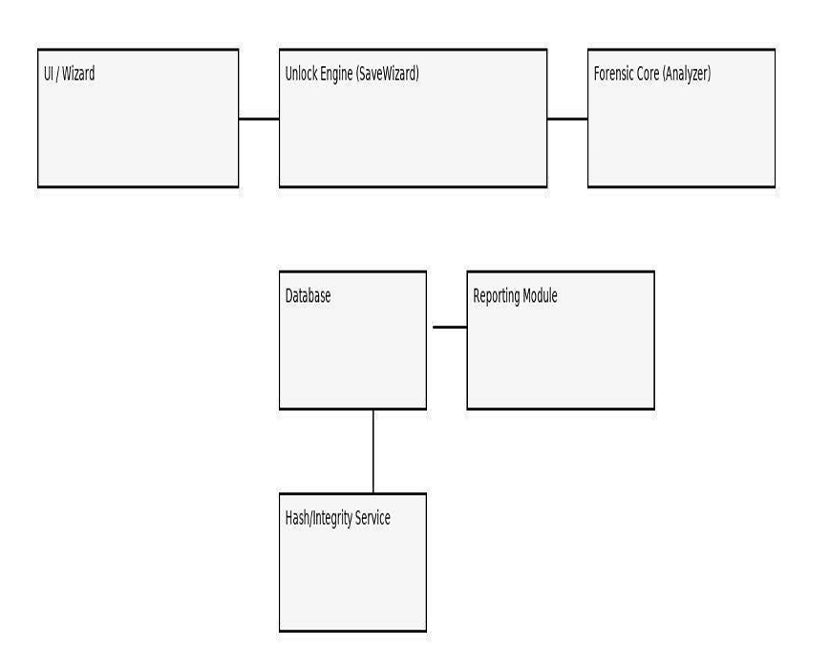
COMPONENT DIAGRAM

Slide 14
MODULES
User Interface Module: Provides a user-friendly dashboard for investigators to upload, decrypt, and analyze digital evidence securely and efficiently.
Save Wizard Integration Module: Connects the forensic system with the Save Wizard tool to decrypt encrypted save files within a controlled forensic environment.
Data Processing Module: Handles preprocessing of evidence data including error handling, normalization, and verification for accurate analysis.
Security Module: Ensures evidence integrity and access control using hashing, encryption, and detailed audit logging of user actions.
Reporting Module: Generates detailed, timestamped forensic reports formatted to legal standards for court admissibility and case documentation.

Slide 15
ALGORITHM
.
Initialize sensors and I/O pins.
Continuously read echo time → calculate distance.
Compare distance with set thresholds:
<30 cm → continuous alert.
30–80 cm → intermittent alert.
80 cm → safe zone.

Slide 16
TESTING
Unit Testing – Validate individual modules (e.g., decryption, hashing, reporting).
Integration Testing – Ensure Save Wizard integrates seamlessly with the analysis scripts.
Functional Testing – Confirm all user operations (import, decrypt, report generation) perform as expected.
Security Testing – Verify encryption (AES-256) and access controls work properly.
Performance Testing – Evaluate processing time, accuracy, and scalability of the forensic analysis.

Slide 17
Test Case ID | Test Description | Expected Output | Actual Output | Status
TC-01 | Upload Encrypted Save File | File accepted & integrity hash generated | ✅ File uploaded successfully | Pass
TC-02 | Run Decryption via Save Wizard | File decrypted in sandbox | ✅ Decryption complete | Pass
TC-03 | Hash Validation | MD5/SHA256 match pre- & post-analysis | ✅ Hashes matched | Pass
TC-04 | Unauthorized Access Attempt | Access denied, logged event | ✅ Access denied, audit logged | Pass
TC-05 | Report Generation | PDF report with all evidence metadata | ✅ Generated detailed report | Pass

Slide 18
PERFORMANCE ANALYSIS
R
Evaluated two machine learning models for efficiency:
Random Forest Regressor
Support Vector Machine (SVM) Regressor
Metrics Used:
Mean Squared Error (MSE)
R² Score
Accuracy (%)
Computation Time (seconds)
Results:
Random Forest → MSE: 0.042 | R²: 0.93 | Accuracy: 94.5% | Time: 2.47s
SVM → MSE: 0.065 | R²: 0.89 | Accuracy: 91.2% | Time: 3.12s

Slide 19
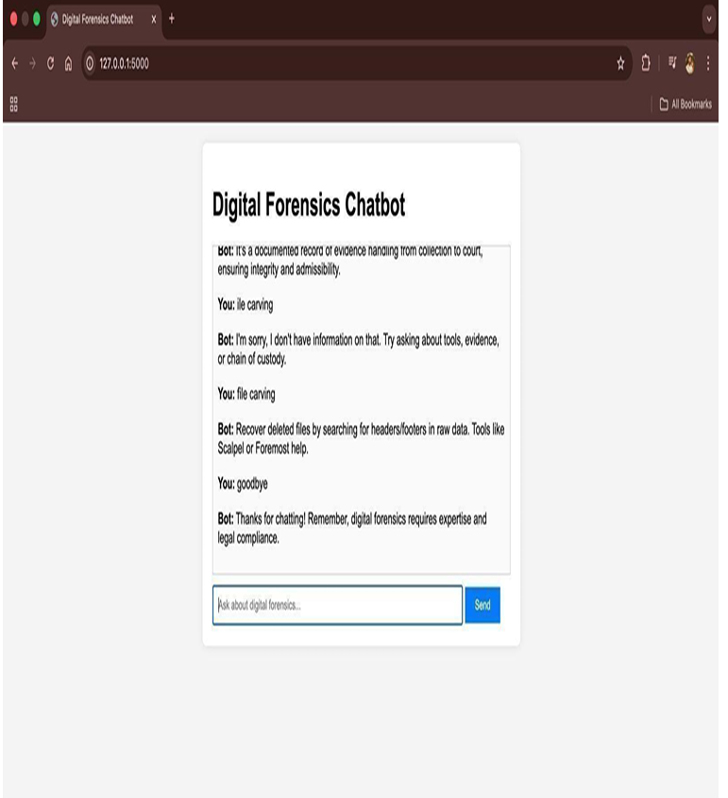
SCREENSHOTS

Slide 20
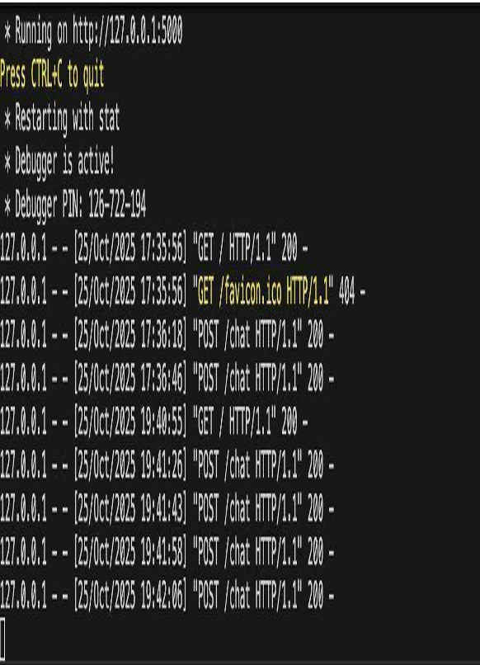

Slide 21
CONCLUSION
Save Wizard integration enhances unlocking and analysis of encrypted evidence
Automation improves efficiency, reliability, and forensic integrity
Machine learning assists in validating digital evidence
Ethical use with adherence to forensic standards ensures admissibility

Slide 22
FUTURE WORKS
Incorporate AI-based anomaly detection to automatically identify suspicious patterns in forensic data.
Extend system capabilities to include cloud and network forensic tools for diverse digital environments.
Enhance process automation with blockchain technology to secure and verify the chain of custody.
Integrate data correlation from multiple sources for more comprehensive forensic analysis.
Develop advanced AI-driven multimedia forensic techniques for image, video, and audio authentication.
Improve user interfaces with visualization dashboards showing AI-based insights and alerts.
Establish legal and ethical frameworks governing AI and blockchain use in forensic workflows.

Slide 23
SDG ALIGNMENTS
Primary goal: forensic analysis project could support in uncover digital evidence that helps in solving cybercrimes, fraud, or data breaches, contributing to accountability. Target 16.10 Ensure public access to information and protect fundamental freedoms, in accordance with national legislation and international agreements. Target 9.1:Develop quality, reliable, sustainable, and resilient infrastructure, including regional and transborder infrastructure, to support economic development and human well-being. Target 16.7: Ensure responsive, inclusive, participatory, and representative decision-making at all levels. Target 16.2: Protecting Vulnerable Populations: Forensic tools can uncover child trafficking, sexual abuse, and exploitation, which are crucial in achieving

Slide 24
CONCLUSION
Save Wizard integration significantly enhances the ability to unlock and analyze encrypted digital evidence.
Automation streamlines forensic workflows, improving speed, consistency, and reducing human error.
Machine learning techniques assist in validating and classifying digital evidence for higher accuracy.
The system maintains forensic integrity by adhering to strict evidence preservation and chain-of-custody protocols.
Ethical considerations are embedded to ensure tools comply with legal standards for admissible evidence.
Automated reporting and documentation improve transparency and reproducibility in investigations.
.

